Slide 1
How to: Data Write-Back to Data Warehouse in Fabric from Power BI
Jon Stjernegaard Vöge

Slide 2
Jon Stjernegaard vöge
professional
Senior Consultant at Inspari – a valantic company, driving Power Platform & Fabric projects and community engagement
Education
MSc. Business Administration & E-Business from Copenhagen Business School, Denmark
Passion
Empowering business users to work better with data, making better decisions, and take matter into their own hands.
personal
28 years old, hobby cyclist, puzzle and board game nerd

Slide 3
agenda
FINAL SOLUTION DEMO
Why even bother with write-back in Power BI/Fabric?
THE CHALLENGE
Why write-back in Microsoft Fabric is more challenging than usual.
THE SOLUTION
How to built a low-code combined Power Apps + Power Automate solution for data write-back to Fabric Data Warehouses
RECAP
What you should remember to build your own solution.

Slide 4
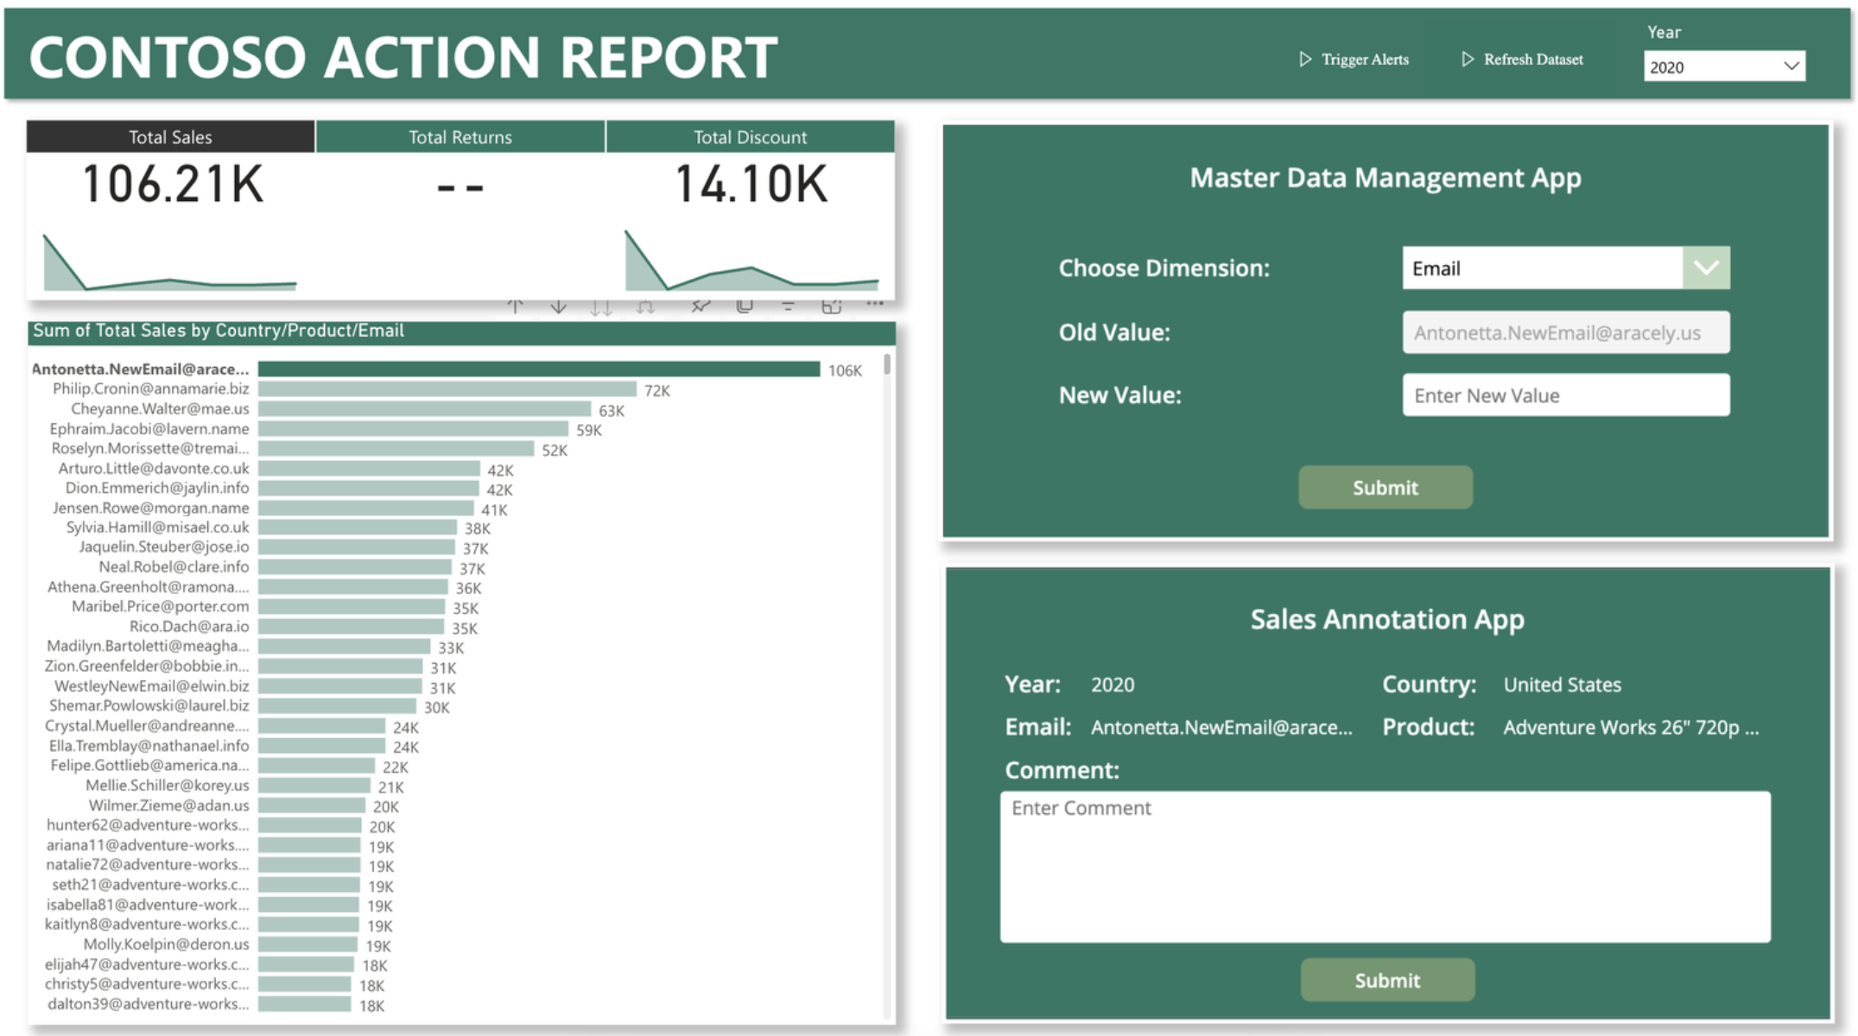
Solution demo

Slide 5
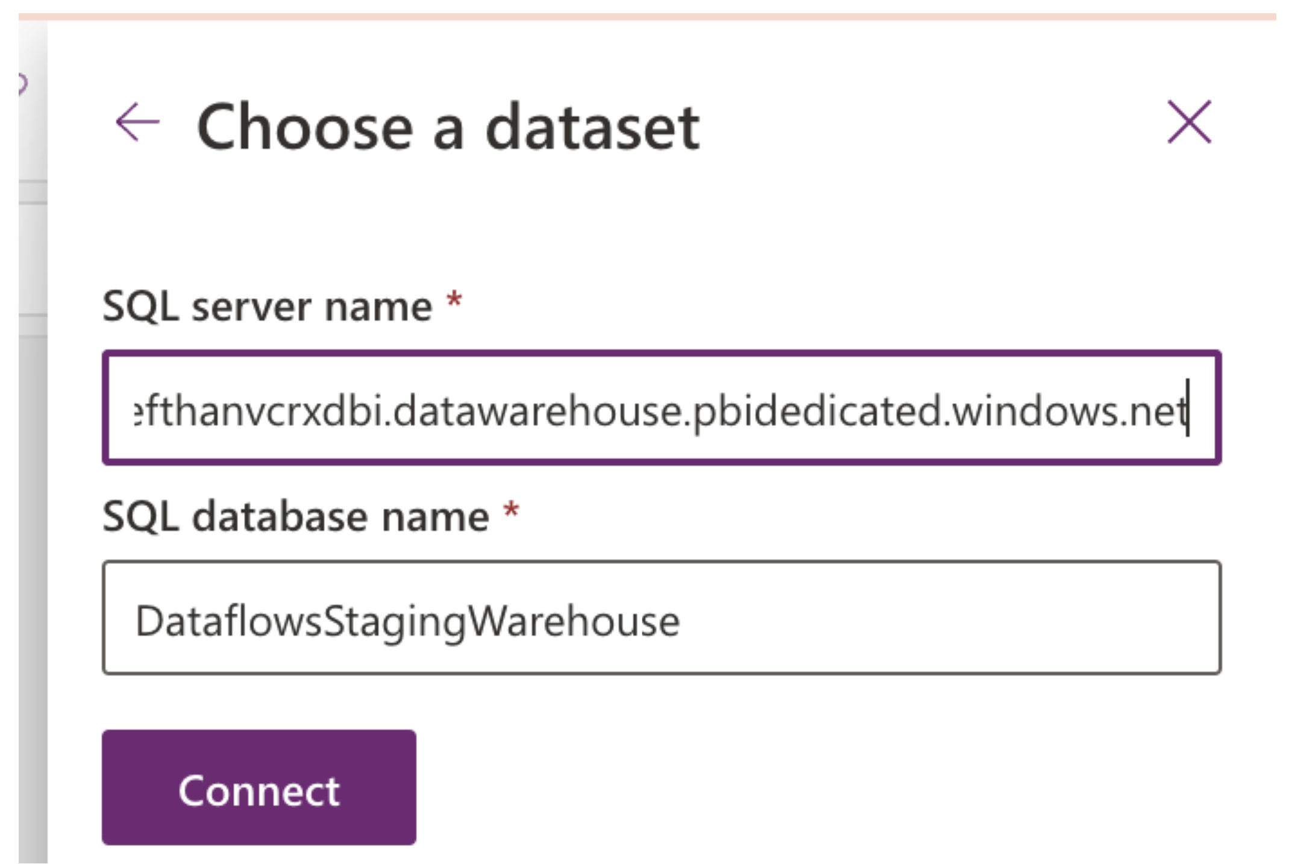
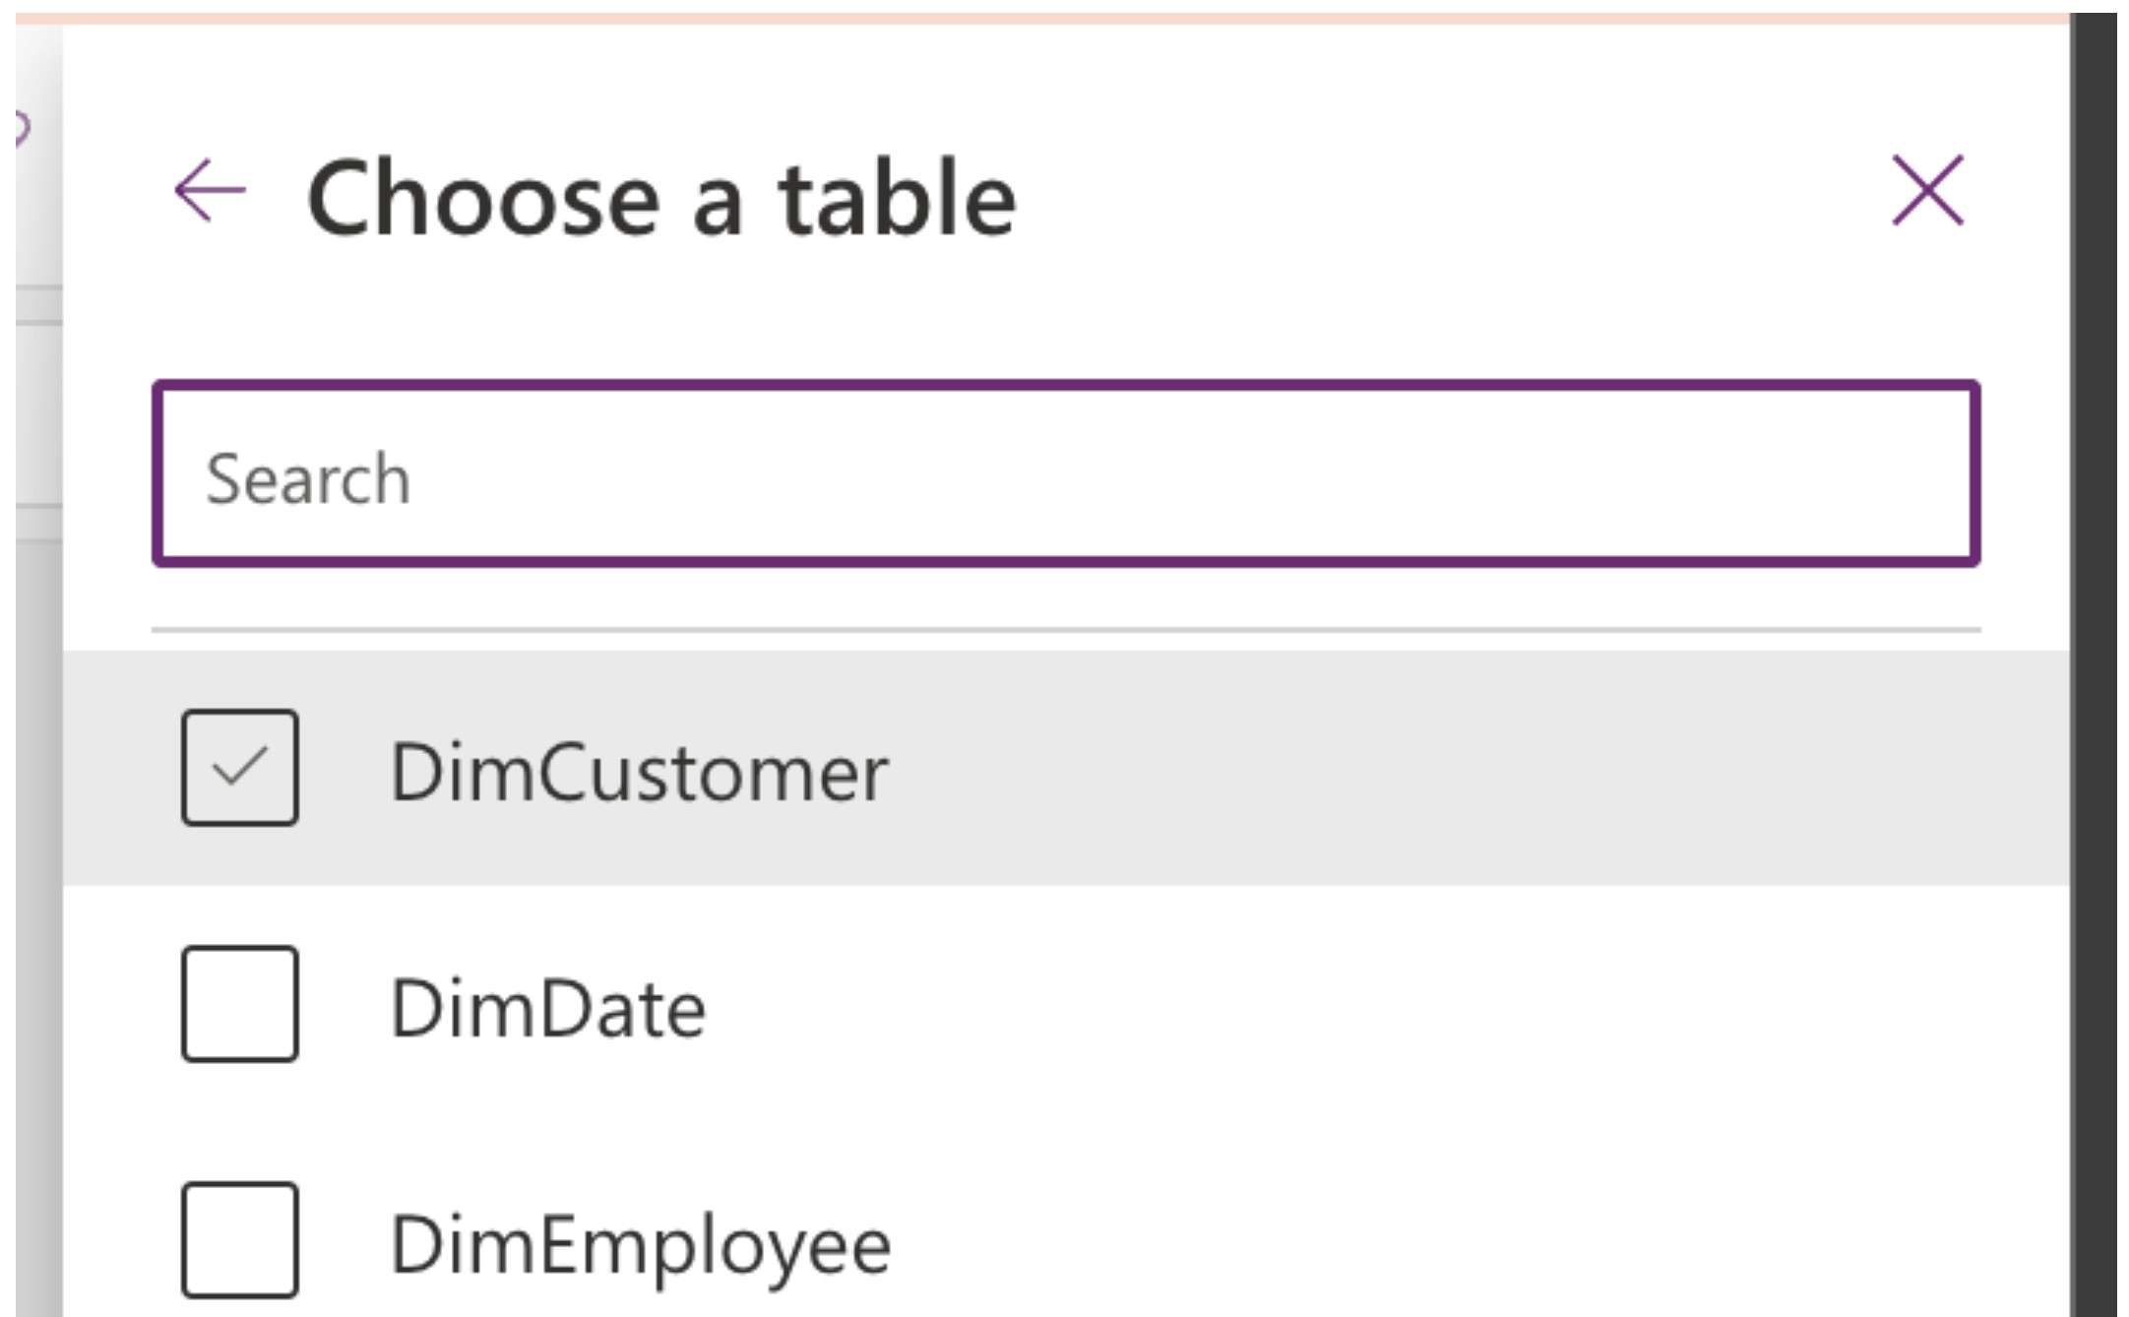
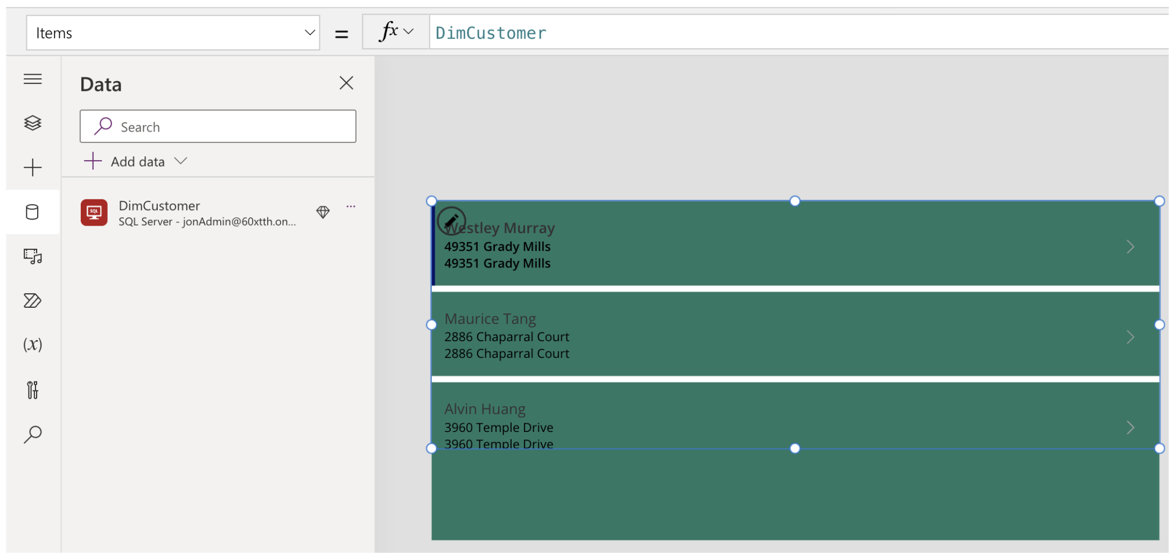
We can connect to Fabric Data Warehouses in Power Apps, and display DATA:

Slide 6
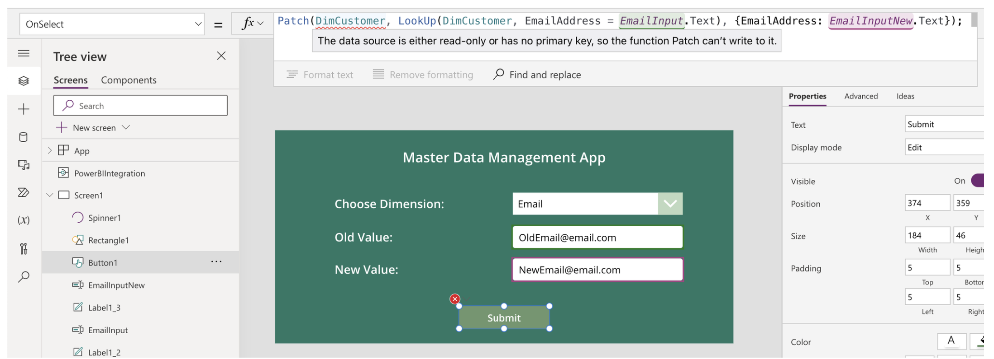
… but native Write-Back is not possible due to lack of enforced Primary Keys in Fabric.

Slide 7
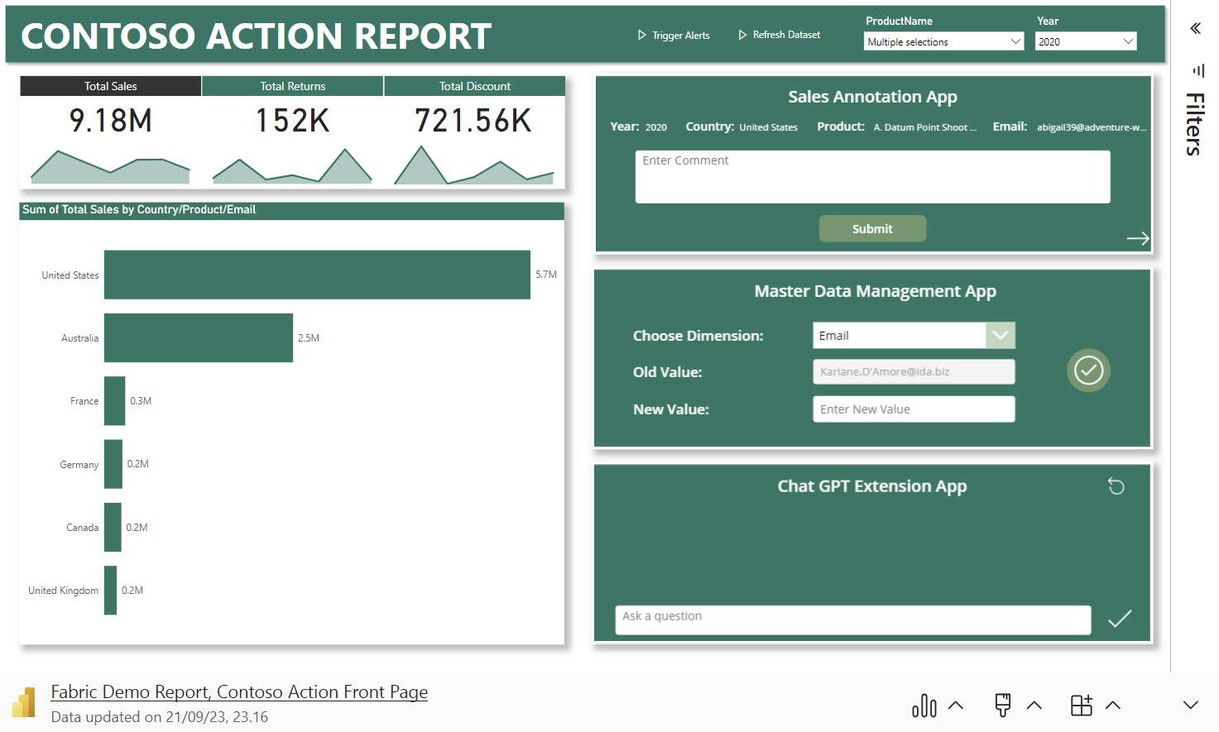
Bonus: Power Automate embedded in Power Apps embedded in Power BI embedded in Power Point

Slide 8
Recap:
Power Apps embedded in Power BI allows the end user to dynamically read, filter and combine data from Power BI Semantic Models and external data sources.
Power Apps can’t natively write-back to Fabric Data Warehouses, due to lack of enforced Primary Keys
Power Automate however can write to Fabric Data Warehouses by submitting Insert/Update SQL statements.
These Power Automate flows can be dynamically parameterized and orchestrated from within a Power App, embedded in Power BI, giving users write-back functionality directly in their reports.

Slide 9
Additional Resources:
Power Apps embedded in Power BI allows the end user to dynamically read, filter and combine data from Power BI Semantic Models and external data sources.
Power Apps can’t natively write-back to Fabric Data Warehouses, due to lack of enforced Primary Keys
Power Automate however can write to Fabric Data Warehouses by submitting Insert/Update SQL statements.
These Power Automate flows can be dynamically parameterized and orchestrated from within a Power App, embedded in Power BI, giving users write-back functionality directly in their reports.

Slide 10
Additional Resources:
Articles:
Write-back to Fabric: https://www.linkedin.com/pulse/live-data-write-back-microsoft-fabric-warehouse-from-jon
Sync Dataverse to Fabric: https://www.linkedin.com/pulse/microsoft-fabric-power-platform-how-get-your-data-jon
Fabric Data Ingestion & Transformation for analysts: https://www.linkedin.com/pulse/fabric-analysts-part-1-data-ingestion-preparation-stjernegaard-v%25C3%25B6ge-fqu1e
Fabric Data Storage for analysts: https://www.linkedin.com/pulse/tutorial-fabric-analysts-data-storage-serving-jon-stjernegaard-v%25C3%25B6ge-sdgoe
Fabric Data Reporting for analysts: https://www.linkedin.com/pulse/tutorial-fabric-analysts-consuming-reporting-jon-stjernegaard-v%25C3%25B6ge-7lgwe
Fabric Data Activator for analysts: https://www.linkedin.com/pulse/tutorial-fabric-analysts-acting-data-activator-stjernegaard-v%25C3%25B6ge-a6dfe

Slide 11
Questions? feel Free to connect with me. LinkedIn: https://www.linkedin.com/in/jonvoge/ Sessionize: https://sessionize.com/jon-voge Download presentation material from github: https://github.com/Jonvoge/speaker-material

